Slide 1

Library Management System: A Deep Dive into Database Design

Slide 2

The Challenge: Unstructured Data in Libraries
Many small libraries still grapple with data managed manually or stored within poorly structured tables. This archaic approach spawns a multitude of issues:
Duplication of crucial information.
Significant difficulties in updating existing records.
Production of unreliable and inconsistent reports.
For instance, a simple amendment to an author's name might necessitate laborious manual updates across numerous entries, leading to errors and inefficiencies.
This project's core motivation is to engineer a clean, normalised database capable of accurately and efficiently supporting daily library operations, including comprehensive management of books, borrowers, and loan transactions.

Slide 3
Unnormalised Form (UNF): A Recipe for Disaster
Data Redundancy
Update Anomaly
The same borrower or book details are repeated across multiple records, wasting storage and leading to inconsistencies.
Changing a single piece of information, such as an author's name, requires updating numerous rows, inviting errors and overlooking entries.
Insertion Anomaly
Deletion Anomaly
New books cannot be added to the system unless they are immediately borrowed, hindering inventory management.
Erasing a loan record could inadvertently delete the only existing information about a specific borrower or a unique book, resulting in irreversible data loss.
Initially, all data might reside within a single, unnormalised table. This arrangement, however, leads to severe complications, as illustrated above. These fundamental flaws unequivocally demonstrate why UNF is entirely unsuitable for any functional, real-world system.

Slide 4

Achieving Data Purity: Normalisation to 3NF
To systematically resolve the issues inherent in UNF, we meticulously normalise the database in progressive stages: from UNF to 1NF, then to 2NF, and finally achieving the robust 3NF.
1NF: Atomic Values & Primary Keys
2NF: Eliminating Partial Dependencies
3NF: Removing Transitive Dependencies
Ensuring each column contains atomic values and identifying unique primary keys for every table.
Separating entity-specific data from transactional data, removing any non-key attribute that depends only on a part of the primary key.
Eliminating attributes that are transitively dependent on the primary key, particularly by decoupling authors from book details into their own distinct entities.
The culmination of this process is a 3NF schema, where each table elegantly represents a singular concept, and all non-key attributes are exclusively dependent on their respective primary keys.

Slide 5
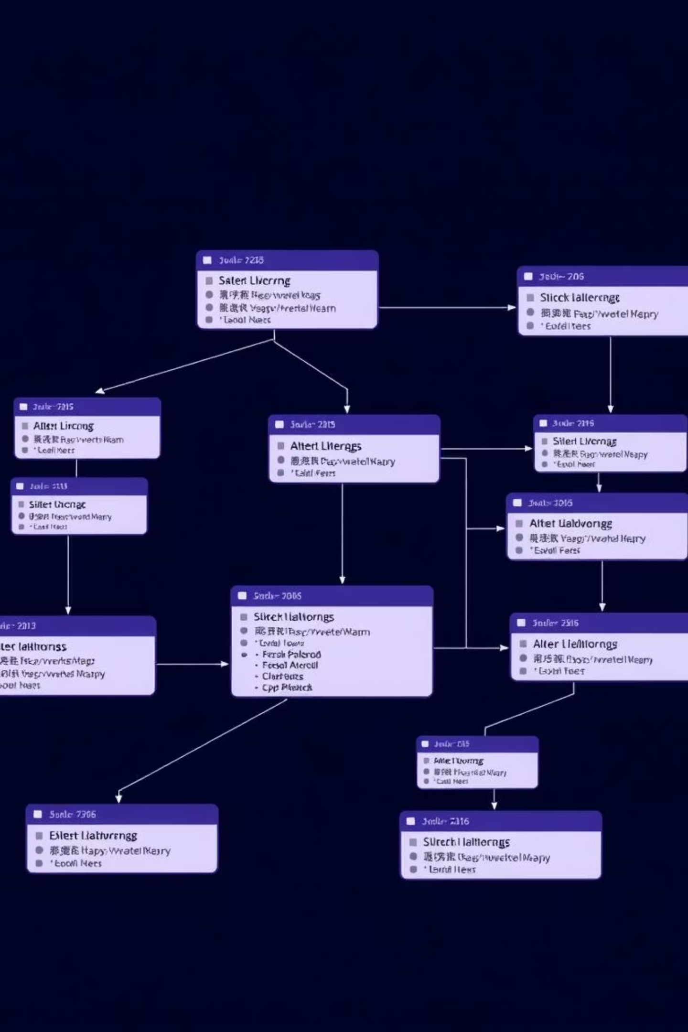
Architecting Relationships: The ERD
This slide provides a clear visualisation of our system's Entity-Relationship Diagram. Understanding these relationships is crucial:
The Authors–Books relationship is one-to-many, signifying that a single author can be credited with multiple literary works.
The Borrowers–Loans relationship is also one-to-many, indicating that one borrower can have several active or historical loan records.
The Books–Loans relationship illustrates that a single book can be borrowed repeatedly over various timeframes.
The strategic application of primary and foreign keys is paramount for enforcing referential integrity, guaranteeing that every loan record consistently references valid and existing borrowers and books.

Slide 6
Specialised Entities: Table Responsibilities
Each table within our normalised database is designed with a clear, singular responsibility, preventing data overlap and promoting system clarity.
Borrowers Table
Authors Table
Exclusively stores information pertaining to library patrons, such as names, contact details, and membership IDs.
Manages author data independently, allowing for consistent author information across all books.
Books Table
Loans Table
Contains metadata for each book, including titles, ISBNs, publication dates, and references authors via a foreign key.
Records transactional data for each loan, such as borrow dates, due dates, and the current status of the loan.
This meticulous separation is a direct benefit of achieving 3NF, effectively eliminating redundancy and preventing data inconsistencies across the system.

Slide 7

Application in Action: CRUD Operations
In our upcoming live demonstration, I will showcase the fundamental CRUD (Create, Read, Update, Delete) operations of our Library Management System.
Firstly, we will walk through the process of adding and updating book or borrower records, highlighting the ease and efficiency of these actions.
Subsequently, I will illustrate how the system rigorously enforces crucial business rules. For example, attempting to delete a book that is currently on loan will be prevented, safeguarding data integrity.
This demonstration will underscore how optimal database design, coupled with intelligent application logic, collaboratively protects and maintains the integrity of our valuable data.

Slide 8

Insightful Analytics: Queries & Dashboard
Building upon our normalised tables, the system effortlessly facilitates JOIN queries, enabling complex data retrieval such as:
Listing all current outstanding loans.
Identifying all borrowers, including those without active loans.
The intuitive dashboard provides real-time Key Performance Indicators (KPIs), offering instant insights into:
The total number of books in the inventory.
The count of active loans.
A clear overview of overdue loans.
This clearly demonstrates how a meticulously designed database directly underpins accurate analytics and informed decision-making processes.

Slide 9

Key Learnings: Design, Rules, and Testing
This project has provided several invaluable insights:
Normalisation is not merely theoretical: Its direct and profound impact on overall system quality and performance is undeniable.
Business rules require robust enforcement: These should be applied not only at the user interface level but also rigorously enforced within the service or database layers for maximum protection.
Automated testing is indispensable: As systems evolve and grow, comprehensive automated testing becomes critical to prevent regressions and maintain stability.

Slide 10




The Road Ahead: Future Enhancements
Enhanced Security
Web-Based Architecture
Implementing robust authentication and role-based access control to secure sensitive data and operations.
Migrating the application to a scalable web platform using frameworks like Flask or Django for broader accessibility.
Automated Reminders
Advanced Analytics
Adding features such as automated email reminders for overdue books to improve borrower accountability.
Developing more sophisticated analytical tools and reporting capabilities for deeper insights into library operations.
These proposed improvements aim to significantly enhance the system's scalability, security, and overall readiness for production environments.

